Slide 1
The Little Girl
A Story by: Katherine Mansfield
Class IX PROSE

Slide 2
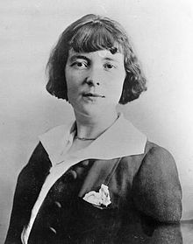
Katherine Mansfield

Slide 3
ABOUT THE AUTHOR
Born | Kathleen Mansfield Beauchamp 14 October 1888 Wellington, New Zealand
Died | 9 January 1923 (aged 34) France
Pen name | Katherine Mansfield
Occupation | Short story writer, poet
Language | English (New Zealand English)
Nationality | New Zealand (British subject)
Alma mater | Queen's College, London
Literary movement | Modernism

Slide 4
Do you feel you know your parents better now, than when you were much younger? Perhaps you now understand the reasons for some of their actions that used to upset you earlier.
?

Slide 5
THEME
The title of the story refers to the main character that we will come across- the little girl, named Kezia.
The theme of the story is the relationship between children and their parents and the writer wants to tell us that children
share a very important bond of love with their parents.

Slide 6
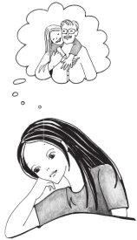

Slide 7
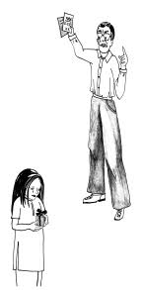

Slide 8
MORAL
The moral of the short story 'The Little Girl' by Katherine Mansfield is that parents should not be indifferent to their children. They should show their love towards their children even when too tired from work and do not have time for them.

Slide 9
SUMMARY

Slide 10
Kezia was a little girl. She feared her father. She thought that her father was like a giant. He had big hands and a big neck. His mouth was also very big. She always avoided him. She thought that he was very cruel.
Kezia’s father worked in an office. He went to an office in the morning. Before going, he went to the little girl’s room. He gave her a casual kiss. The father went to the office in a carriage. She felt very happy when the father had gone.

Slide 11
The Little Girl
In the evening, the little girl’s father came back. He spoke loudly in the house. Kezia feared her father’s loud voice. Her mother would ask her to go and take
off his shoes. When she entered his room, he looked at her sternly. Kezia thought that her father was a hard-hearted person.

Slide 12
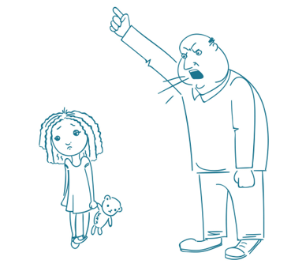

Slide 13
The Little Girl
One day Kezia made a pin-cushion. She wanted to present it to her father on his birthday. She needed paper to stuff the pin- cushions. She found some sheets of paper in her father’s room. She tore the sheets to stuff the pin-cushion. Her father had written an important speech on them. He was very angry with her. He took a stick and beat her severely. He told her not to touch anything that did not belong to her. Kezia wept bitterly. She wondered why God had made fathers. Now she trembled even at the sight of her father.

Slide 14
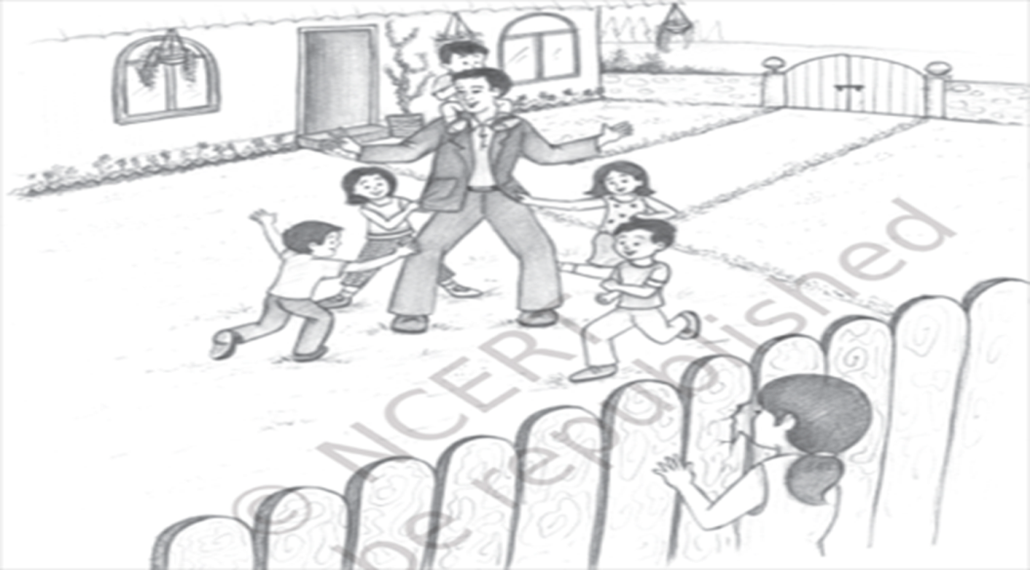
The Little Girl
One day, Kezia saw her neighbour, Mr Macdonald. He was playing with his children. They all looked very happy. But Kezia’s father never played with her. Now she thought that there were different kind of fathers in the world.
Her own father was very cruel.

Slide 15
The Little Girl
After a few days, Kezia’s mother became ill. Her grandmother took her to hospital. Kezia was alone in the house with the nurse. She had to sleep alone in her bedroom. At night, she had a horrible dream. She saw that there was a butcher with a knife. She was terrified. She gave a loud cry. Her father came into her room. He lifted her and took her to his own bed. She lay beside her father.

Slide 16
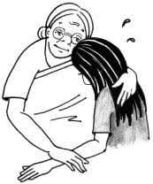

Slide 17
The Little Girl
He was tired and fell asleep before her. She was lost in thoughts. She thought that he had to work hard every day. He came in the evening. Then he was too tired to play with her. She thought that it was her fault to tear those important papers.
She realised that her father was not bad. He had a big and loving heart.

Slide 18
The Little Girl
As

Slide 19
Words Meaning
Glad sense of relief: feeling relaxed
Fainter and fainter: to lessen or reduce
slip down: come down quietly and unwillingly
Stutter: to stammer, to speak with pauses
given it up: stopped doing it
Wretched: unhappy, sad
on the brink of suicide: about to commit suicide
suicide: kill oneself
Gravely: seriously.
Wandered into: went into, by chance
Scraps: small pieces of cloth or paper etc that are not needed.

Slide 20
The Little Girl
Some questions and answers:
Q.I. What made Kezia’s father punish her? Was he right to do so?
Ans. Kezia’s father had written a speech on some papers. Kezia had made a pin-cushion for her father on his
birthday. She needed paper to stuff the pincushion and put them into the cushion.
So her father punished her. Father was not right to beat her. He could have made Kezia realize her mistake with love
Q.2. Why did the little girl start making the pin-cushion?
Ans. One day Kezia was suffering from cold. She was kept indoors. Her father’s birthday was next week. Her grandmother suggested that she should present a pin-cushion to her father. So she started making the pin- cushion.
Q.3. What did she stuff it with? Why was the stuffing very important for her father? Did she know that it was important?
Ans. Kezia found some sheets of paper in her father’s bedroom. She tore them into pieces. She stuffed the pin- cushion with those pieces. The stuffing was very important for her father. An important speech was written on those papers. But the little girl did not know about it.

Slide 21
The Little Girl
Q.4. Kezia looked through a hole in the fence into Mr MacDonald’s garden.
What did she see?
Ans. Kezia saw that Mr Macdonald was playing with his children. They were running around the flower beds Baby Mao was on his shoulders. The two little girls were hanging on to his coat pockets. They were very happy.
Q.5. Describe the departure of Kezia’s father for his office.
Ans. Kezia’s father went to the office early in the morning. Before going, he went to Kezia’s room. He gave her a kiss. She said goodbye to her father.
Q.6. Describe the arrival of Kezia’s father at home from the office.
Ans. Kezia’s father returned from office in the evening flies coming was a noisy affair. He raised his voice on entering the house. Kezia’s mother asked her to take off her father’s shoes.

Slide 22
The Little Girl
So

